Slide 1



CAPSTONE PROJECT
Sleep Health and Lifestyle Analytics: A Data-Driven Study of Stress, Activity, and Sleep Disorders
Presented By
Student Name: Sudiksha d
College Name: Keshav Memorial Institute of Technology
Department: Computer Science and Engineering
Email ID: sudiksha1604@gmail.com

Slide 2
OUTLINE:
Problem Statement
Proposed System/Solution
System Development Approach
Result
Conclusion
Future Scope
References

Slide 3
Problem Statement:
Sleep is essential for maintaining physical and mental health, but modern lifestyle factors such as high stress, irregular work schedules, and low physical activity are negatively affecting sleep quality. Many people experience sleep disorders like insomnia and sleep apnea without understanding how factors such as occupation, stress levels, BMI, and daily habits influence their sleep patterns.
Analyzing raw health data can be difficult without proper visualization tools. Therefore, this project develops an interactive Power BI dashboard to analyze sleep duration, sleep quality, stress levels, BMI, physical activity, and sleep disorders. The dashboard helps identify patterns and insights that explain how lifestyle factors impact sleep health.

Slide 4
Proposed Solution:
The proposed solution uses data analytics and visualization techniques to analyze the relationship between lifestyle factors and sleep health. An interactive Power BI dashboard is developed to explore how variables such as sleep duration, stress level, BMI, occupation, physical activity, and daily steps influence sleep quality and sleep disorders.
The system provides clear visual insights that help identify patterns, correlations, and potential risk factors affecting sleep health.
Key Components of the Solution
Data Collection
Data Cleaning and Preparation
Data Analysis and Visualization
Interactive Dashboard Development
Insight Generation

Slide 5
Proposed Solution:
Data Collection
The Sleep Health and Lifestyle dataset is collected containing information such as:
Age and Gender
Occupation
Sleep Duration
Quality of Sleep
Stress Level
BMI Category
Physical Activity Level
Daily Steps
Sleep Disorders
Data Preparation
The dataset is imported into Power BI.
Data cleaning is performed to:
Remove missing or inconsistent values
Standardize categorical data
Data transformation and formatting are applied to prepare the dataset for analysis.

Slide 6
Proposed Solution:
Data Analysis
Different lifestyle factors are analyzed to understand their impact on sleep health.
Key relationships analyzed include:
Sleep Duration vs Occupation
Stress Level vs Sleep Disorder
BMI Category vs Sleep Disorder
Physical Activity vs Sleep Quality
Gender vs Sleep Health
Visualization Development
Various Power BI visuals are created to represent insights:
These visualizations help users easily explore and interpret sleep health patterns.
• Bar Charts | • Line Charts
• Pie Charts | • Stacked Column Charts
• KPI Cards | • Filters & Slicers

Slide 7
Proposed Solution:
Dashboard Development
An interactive Power BI dashboard is created that includes:
Sleep health overview metrics
Gender-based sleep analysis
Occupation-based sleep patterns
Sleep disorder analysis
BMI and lifestyle factor analysis
Interactive filters and slicers allow users to analyze data dynamically by gender, occupation, and sleep disorder type.
Insights and Decision Support
The dashboard helps:
Identify occupations with higher stress levels
Understand how BMI and physical activity influence sleep quality
Detect patterns related to insomnia and sleep apnea
Provide data-driven insights for improving sleep health awareness.

Slide 8
System Approach:
The system approach describes the methodology used to analyze sleep health data using Power BI. The approach focuses on collecting the dataset, preparing the data, and creating interactive visualizations to explore relationships between lifestyle factors and sleep patterns.
System Requirements
Hardware Requirements
Processor: Intel i3 / i5 or higher
RAM: Minimum 4 GB (8 GB recommended)
Storage: 500 MB or more free space
Software Requirements
Microsoft Power BI Desktop
Microsoft Excel / CSV dataset
Windows Operating System

Slide 9
System Approach:
Dataset Used: Sleep Health and Lifestyle Dataset
Dataset Description:
This dataset contains information about individuals’ sleep habits and lifestyle factors that influence sleep health. It helps analyze the relationship between sleep duration, stress levels, physical activity, BMI, occupation, and sleep disorders.
Key Attributes in the Dataset
Purpose of the Dataset
The dataset is used to analyze how different lifestyle factors affect sleep patterns and to identify trends related to sleep quality and sleep disorders.
Age | Stress Level
Gender | BMI Category
Occupation | Physical Activity Level
Sleep Duration | Daily Steps
Quality of Sleep | Heart Rate
Sleep Disorder | Blood Pressure

Slide 10
System Approach:
Power BI Features Used:
Slicers: These allow users to dynamically filter the dashboard data.
Gender slicer
Occupation slicer
Sleep disorder filter
KPI Cards: Used to display key metrics such as:
Average Sleep Duration
Average Stress Level
Average Physical Activity Level
Bar Charts
Stress level by occupation
Sleep duration by occupation

Slide 11
System Approach:
Power BI Features Used:
Pie Charts: Used to represent:
Gender comparison in sleep duration and quality
BMI category distribution
Line / Combined Charts: Used to compare:
Daily steps and physical activity level across occupations
Stacked Column Charts: Used to analyze:
Sleep disorders by occupation
BMI category distribution across occupations

Slide 12
Result:
The developed Power BI dashboard successfully visualizes the relationship between sleep health and lifestyle factors such as stress level, physical activity, BMI, occupation, and sleep disorders. The interactive dashboard enables users to explore patterns and trends in sleep duration and sleep quality.
Key Results
Identification of occupations with higher stress levels and lower sleep quality.
Analysis of the relationship between physical activity and sleep duration.
Visualization of BMI category distribution and its impact on sleep disorders.
Comparison of sleep health patterns across gender and occupations.
Project Resources
GitHub Repository: [Project Repository Link]
Google Drive: [Project Files Link]

Slide 13
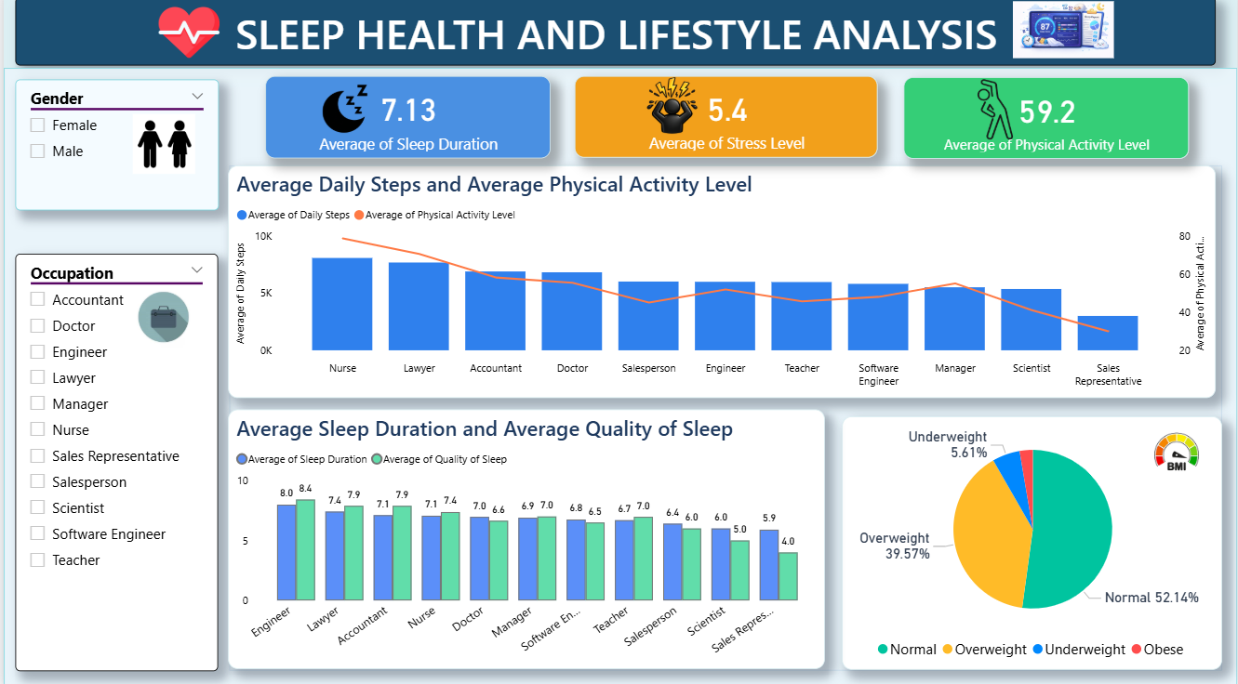
Result:
Sleep Health Overview:
Overview dashboard showing sleep health, stress, activity, and BMI insights. [Link]

Slide 14
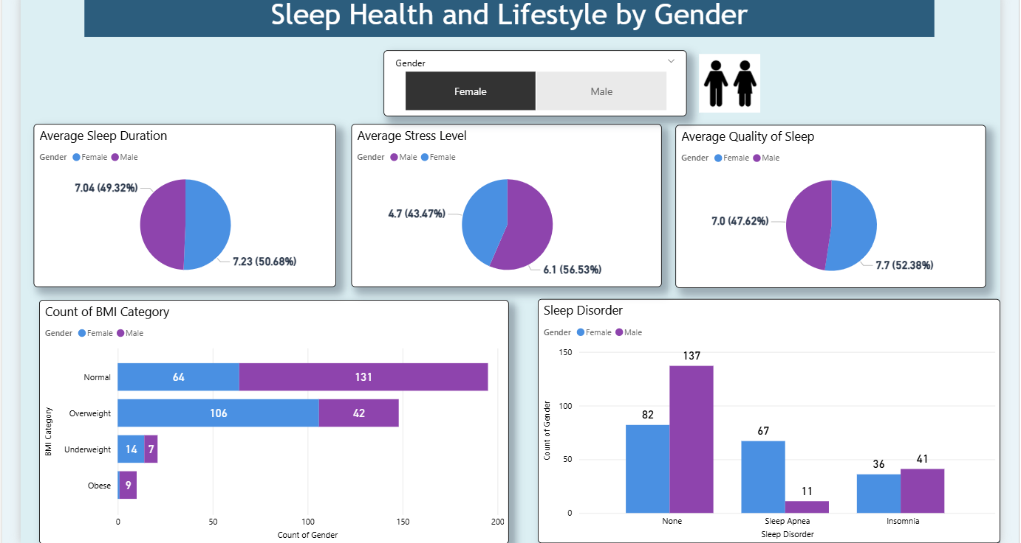
Result:
Sleep Health Analysis By Gender:
Gender-based comparison of sleep duration, stress levels, sleep quality, BMI, and sleep disorders. [Link]

Slide 15
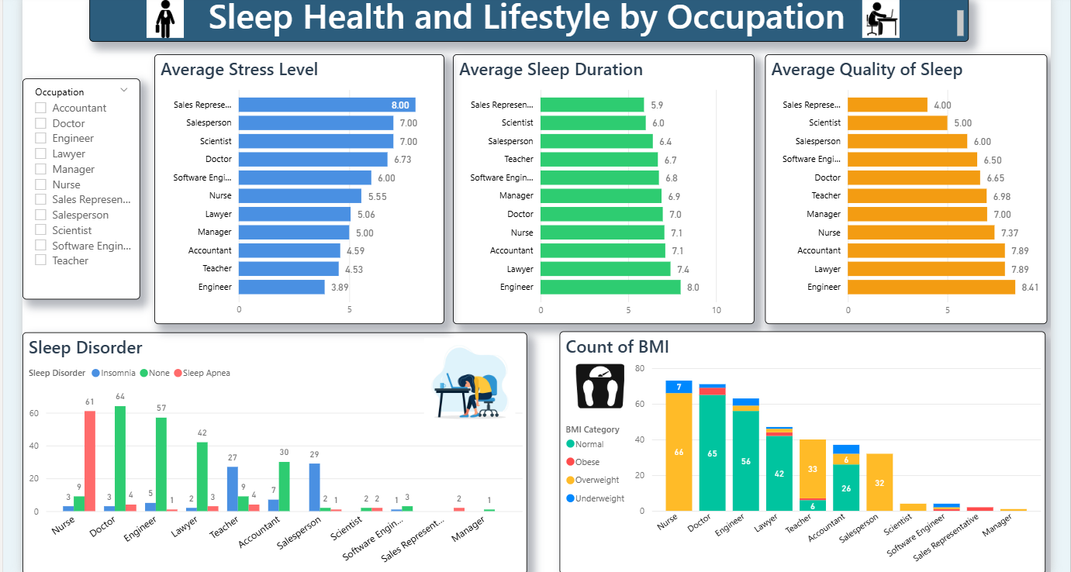
Result:
Sleep Health and Lifestyle by Occupation:
Occupation-based analysis of stress levels, sleep duration, sleep quality, BMI, and sleep disorders. [Link]

Slide 16
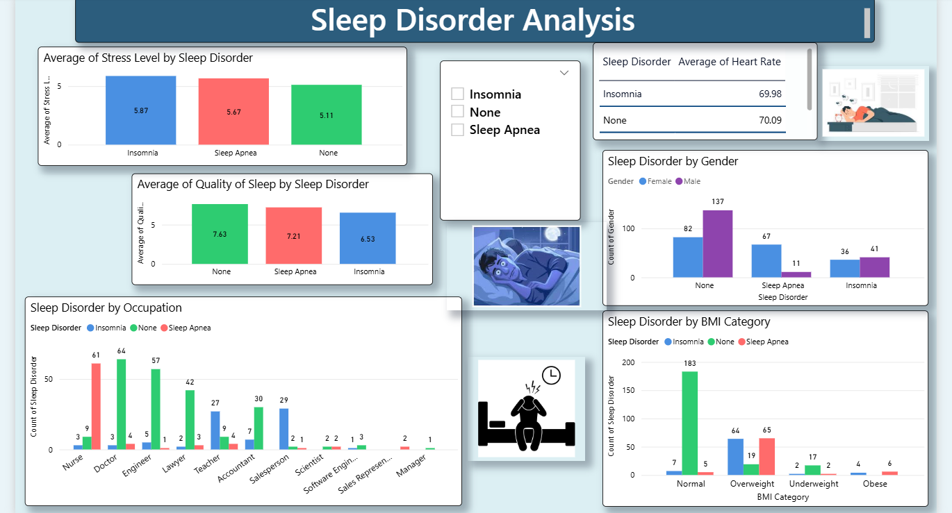
Result:
Sleep Disorder Analysis:
Analysis of sleep disorders based on stress levels, sleep quality, gender, occupation, and BMI. [Link]

Slide 17
Conclusion:
This project successfully analyzes the relationship between lifestyle factors and sleep health using an interactive Power BI dashboard. The analysis highlights how factors such as stress level, physical activity, BMI, occupation, and gender influence sleep duration, sleep quality, and sleep disorders.
The dashboard effectively provides clear visual insights that help identify patterns and trends related to sleep health. Interactive features like filters and slicers allow users to explore the data dynamically.
Challenges
Managing and organizing multiple variables in the dataset
Designing clear and readable visualizations
Selecting appropriate charts to represent relationships
Potential Improvements
Use larger or real-time health datasets
Integrate predictive analytics for sleep disorder prediction
Deploy the dashboard online for wider accessibility
This solution demonstrates how data visualization and analytics can support better understanding of sleep health patterns.

Slide 18
Future scope:
The current project provides valuable insights into sleep health using data visualization. In the future, the system can be enhanced with advanced technologies and additional data sources to provide deeper analysis and more accurate insights.
Integrate larger and more diverse health datasets to improve analysis accuracy.
Implement machine learning models to predict sleep disorders and sleep quality.
Incorporate real-time health data from wearable devices such as smartwatches and fitness trackers.
Develop a web-based or cloud-based dashboard for easier access and sharing.
Add additional health factors like diet, screen time, and mental health indicators.
Enable personalized sleep recommendations based on user lifestyle patterns.
Improve dashboard interactivity with advanced filters and drill-down analysis.
Integrate the system with healthcare applications to support medical research and wellness monitoring.

Slide 19
References:
Sleep Health and Lifestyle Dataset – Kaggle https://www.kaggle.com/datasets/uom190346a/sleep-health-and-lifestyle-dataset
Microsoft Power BI Documentation – Microsoft Learn https://learn.microsoft.com/power-bi
Power BI Data Visualization Best Practices – Microsoft Documentation
National Sleep Foundation – Research and information on sleep health https://www.sleepfoundation.org
World Health Organization (WHO) – Information on sleep and health research https://www.who.int
Project Resources
GitHub Repository: [Project Repository Link]
Google Drive: [Project Files Link]

Slide 20
Thank You

